Slide 1

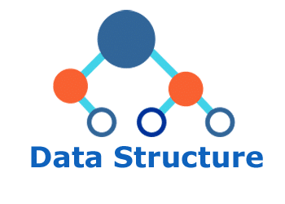
Data structure
(in c)
Lecture 5

Slide 2

Today’s Agenda
Applications Of A Stack
Stack is very important Data Structure which is used by
compiler as well as programmers in many situation.
Compilers use Stack when they use local variables of a function in memory.
Whenever we pass arguments to a function, the compiler always uses Stack for passing these arguments and in the function it again pops these arguments from the stack.

Slide 3
Application of Stack
Whenever compilers encounter a function call, they always stores the address of next instruction to be executed in the Stack, before moving out from calling function to the called function. Similarly, while returning back from a function, the compilers, first pop the last pushed instruction from the stack and then continue with the calling function.
Programmers use Stack to solve some very popular programming problems:
Merge Sort.
Quick Sort.
Tower of Hanoi
Expression solving and conversion(INFIX, POSTFIX and PREFIX)

Slide 4
Application 2
Push
For Example-
void main()
{
……..
……..
f1();
printf(“Hi”);
}
void f1()
{
……….
……….
f2();
printf(“\nBye”);
}
Printf(“\nBye”)
printf(“Hi”);
void f2()
{
………….
………….
printf(“/nHello”);
}
Output:
Hello
Bye
Hi

Slide 5
Application 2
Argument
printf(“%d %d %d”, a, b, c);
For Example-
void main()
{
int a=10;
printf(“%d %d %d”,++a,a,a++);
}
a
b
c
a
b
c
12
11
10
12
11
10
OUTPU: 12 11 10

Slide 6
Examples
void main()
{
int a=10;
printf(“%d %d %d”, a,++a,a++);
}
void main()
{
int a=5;
printf(“%d %d %d”,a=10,a,a>6);
}
12
12
10
12
12
10
OUTPUT: 12 12 10
10
5
0
10
5
0
OUTPUT: 10 5 0

